Slide 1

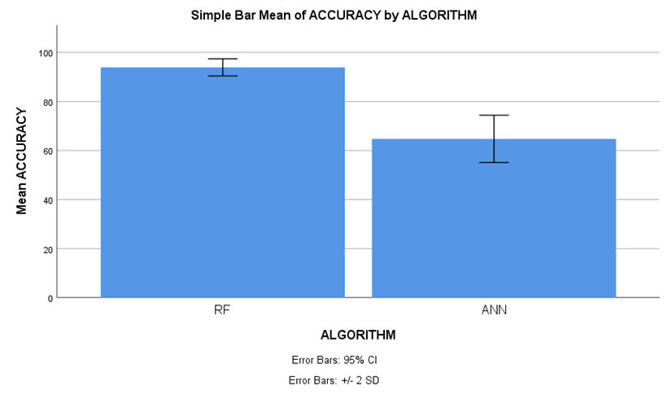
Name: Mr. Telapolu Mani Sai Lokesh Register Number: 192224105
Guided by Dr. R. Manikandan
Ms. Poorani.S
Guided by Dr. Mary Valantina. G
Enhancing social media influence prediction accuracy for marketing strategy through comparative analysis of Random Forest and Artificial Neural Network
Due to its ability to provide current information on consumer behaviors and industry trends, social media has become an essential instrument for market analysis. Enterprises may acquire a competitive advantage by leveraging social media data to comprehend the inclinations, attitudes, and interaction trends of their customers.
Businesses may make well-informed judgements and modify their marketing plans to successfully satisfy changing consumer expectations thanks to this dynamic platform.
The aim of this study is to separate Innovative Machine Learning (ML) Classifiers to determine which predictive model is most useful for optimizing marketing decisions based on social media data, and to assess the accuracy of social media impact predictions for marketing initiatives.
In this research study , Random Forest algorithm (RFA) is compared with Artificial Neural Network algorithm (ANN) to enhance accuracy.
It has been demonstrated that Random Forest algorithm has proven to be faster when compared with Artificial Neural Network.
INTRODUCTION
MATERIALS AND METHODS
Dimension Reduction
Data Collection/
Pre -Processing
Feature Extraction
High Dimension
Classifier Section
Evaluation Hate Speech
No Hate Speech
Hate Speech Detection from Social Media
RESULTS
Overall , the accuracy of the Random Forest is 93.90 % and it is better than the other algorithms.
Random Forest(RF) - 93.90%
Artificial Neural Network (ANN) - 64.75%
In the present work, Random Forest (RF) is compared with Artificial Neural Network algorithm (ANN), and it depicts that the proposed algorithm gives more accuracy when compared with the rest.
Random Forest algorithm in social media marketing facilitates audience segmentation, content optimization, ad targeting, churn prediction, sentiment analysis, influencer identification, optimal posting times, and customer lifetime value prediction for enhanced marketing effectiveness.
In social media marketing, artificial neural networks (ANNs) can analyze massive volumes of user data to spot patterns and trends, allowing for targeted advertising campaigns and suggestions for relevant content.
Comparative error analysis of Random Forest and Artificial Neural Network
DISCUSSION AND CONCLUSION
The research conducted a thorough comparative analysis between Random Forest (RF) and Artificial Neural Network (ANN)for estimating social media effect forecasting is essential for optimizing marketing tactics, involving a dataset of 1250 samples.
Based on T-test Statistical analysis, the significance value of p=0.036 (independent sample T - test p<0.05) is obtained and shows that there is a statistical significant difference between the group 1 and group 2.
From the work , it is concluded that the Random Forest algorithm attains the high accuracy when comparing with other Machine Learning Algorithms in social media influence prediction accuracy for marketing strategy.
Increased brand awareness and company success are ultimately driven by more individualized campaigns, which are made possible by deeper audience understanding and more precise forecasting.
Using Random Forest for complex data and Artificial Neural Network for easily understood insights improves the accuracy of social media impact prediction, supporting effective marketing strategies. Choosing the right model based on dataset features is essential for making informed marketing decisions and optimizing forecast performance.
Frey, Felix. 2017. “SPSS (Software).” The International Encyclopedia of Communication Research Methods, November, 1–2.
Hänsel, Paul, Max Mittelstaedt, and Mp Online Consulting. 2020. Social Media Marketing: How to Sell Your Products Or Services Successfully as a Business Or Self-Employed Person Using Online Marketing.
Jung, Hyesil, Hyeoun-Ae Park, and Hee Hwang. 2020. “Improving Prediction of Fall Risk Using Electronic Health Record Data With Various Types and Sources at Multiple Times.” Computers, Informatics, Nursing: CIN 38 (3): 157–64.
Lytras, Miltiadis D., Anna Visvizi, and Kwok Tai Chui. 2020. Big Data Research for Social Sciences and Social Impact. MDPI.
Macy, Beverly, and Teri Thompson. 2011. The Power of Real-Time Social Media Marketing: How to Attract and Retain Customers and Grow the Bottom Line in the Globally Connected World. McGraw Hill Professional.
BIBLIOGRAPHY

